Slide 1
Overview of:

Slide 2
Advanced approval system that fully integrates with i-Reporter

Slide 3
Advanced approval system that fully integrates with i-Reporter
Add advanced approval workflows right within the i-Reporter form
When an approval request is made in i-Reporter, the form is routed automatically based on the approval process/workflow
When approvals are performed in sequence to the set approval workflow, the approval form is automatically linked to the i-Reporter form and the digital approval stamp is issued and the forms are saved.

Slide 4
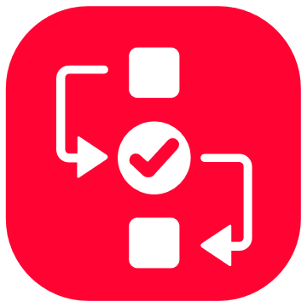
Main Features
Feature only available when using i-Repo WorkFlow
Configuring approval settings
Setting up
Approval flow template for each i-Reporter form definition
Routing based on the inputted data of specific cluster/fields
Use of AND & OR operators for approvals
Perform actions to send an email, Teams, or Slack notifications at any time along the workflow approval process
Use of handwritten signatures or digital stamps to approve forms
Reject and return requests to any point of the approval workflow
Withdraw approval requests
Get notifications via email, Slack, Teams for items needing approval, are approved, or other status changes

Slide 5
Main Features
Feature only available when using i-Repo WorkFlow
Approval progress management of forms (managing approval status)
Manage forms that have been submitted
Pending/In-progress
Returned forms
Forms approved
Manage the forms you can approve
Pending approval
Returned forms
Approved
Connect with i-Reporter to automate approval of forms via digital stamping

Slide 6
Advanced approval system that fully integrates with i-Reporter
Add advanced approval workflows right within the i-Reporter form
When an approval request is made in i-Reporter, the form is routed automatically based on the approval process/workflow
When approvals are performed in sequence to the set approval workflow, the approval form is automatically linked to the i-Reporter form and the digital approval stamp is issued and the forms are saved.

Slide 7
Difference from the approval function in i-Reporter
i-Repo WorkFlow adds advanced approval processes to i-Reporter forms
In i-Reporter, you are limited to the review and approval functions being limited to within a single form.
i-Repo Workflow enables advanced logic operations to the workflow process that cannot be done using the built-in approval functions of I-Reporter forms.

Slide 8
Basic i-Repo WorkFlow example
Multiple approval application workflows can be configured
Multiple different approval workflows can be set for approval workflows
?
Example:
Application for the purchase of different kinds of equipment
1. Purchasing of server equipment uses a form titled: "Purchase order form for server equipment“
2. PC purchase uses a form titled: "Purchase order form for PC“
3. Software purchase uses a form titled: "Purchase order form for software“
4. Software subscription purchase uses a form titled: " Purchase order form for software subscription“
Approval application
Application forms -> These are linked to the i-Reporter forms that are submitted and applied for approval.

Slide 9
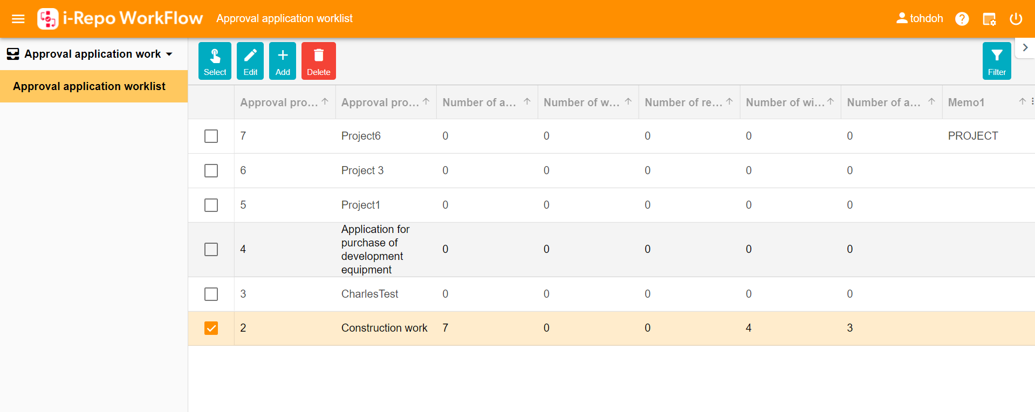
Approval application tasks and the approval workflows they are associated with
List of approval workflows
Approval applications
A single task can have multiple approval workflows.
You can create multiple approval process workflows.
Approval workflow 1
Approval workflow 2
Approval workflow 3
Approval workflow 4

Slide 10
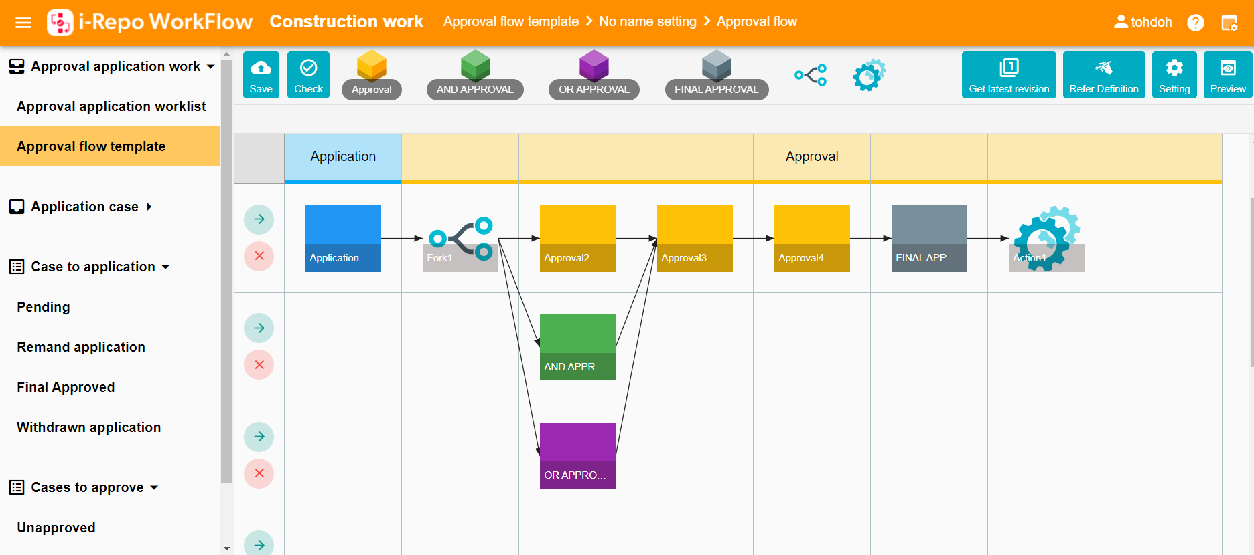
Creating an approval process/workflow
Modules available to set up an approval workflow process
Application form (Auto generated)）
Approved
OR operator
AND operator Final approval削除不可。
Routing
Create an approval process by arranging functions. (pre and post-function checks are in place)
The start of a process generates a function that cannot be removed or deleted.
Approved
AND operator used to require approval of all members of the approval group
Notifications can be sent via email, Slack, or Teams or Connect with other systems using Webhooks
The approval process is routed to a different action based on the value entered on a form. For example the purchase amount for an item.
Final approval is placed at the end of the approval workflow
OR operator used that only one person needs to approve the form out of the approval group

Slide 11
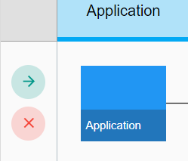
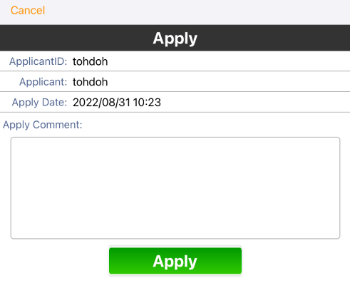
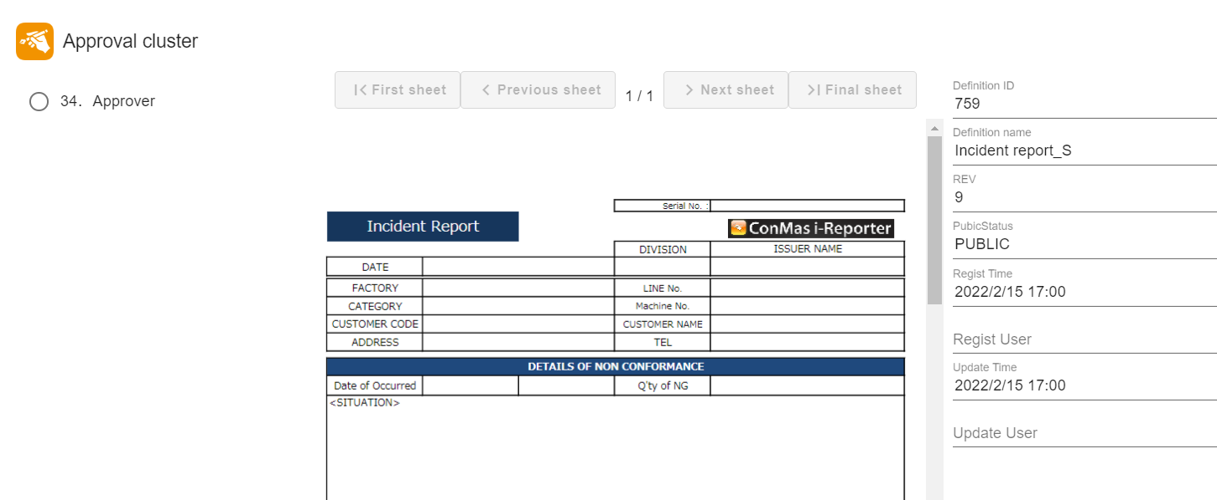
Integration with i-Reporter forms
Link the application process for an approval workflow to an i-Reporter form template.
Specify the "application process" of the approval workflow and the "approval cluster" on the i-Reporter form.
When an application for approval is made within the i-Reporter app via the "approval cluster" an application form is automatically generated.
Name of the form to be linked
Detailed view of the approval cluster (1)
Specify the approval cluster in the i-Reporter form that will be linked to the WorkFlow approval process.
Application process of an approval workflow
An application is generated when someone applied for approval of the form via the "Approval cluster (1)" that is linked to the application process.
The approval cluster (1) is indicated and linked to the application process for the approval workflow.

Slide 12
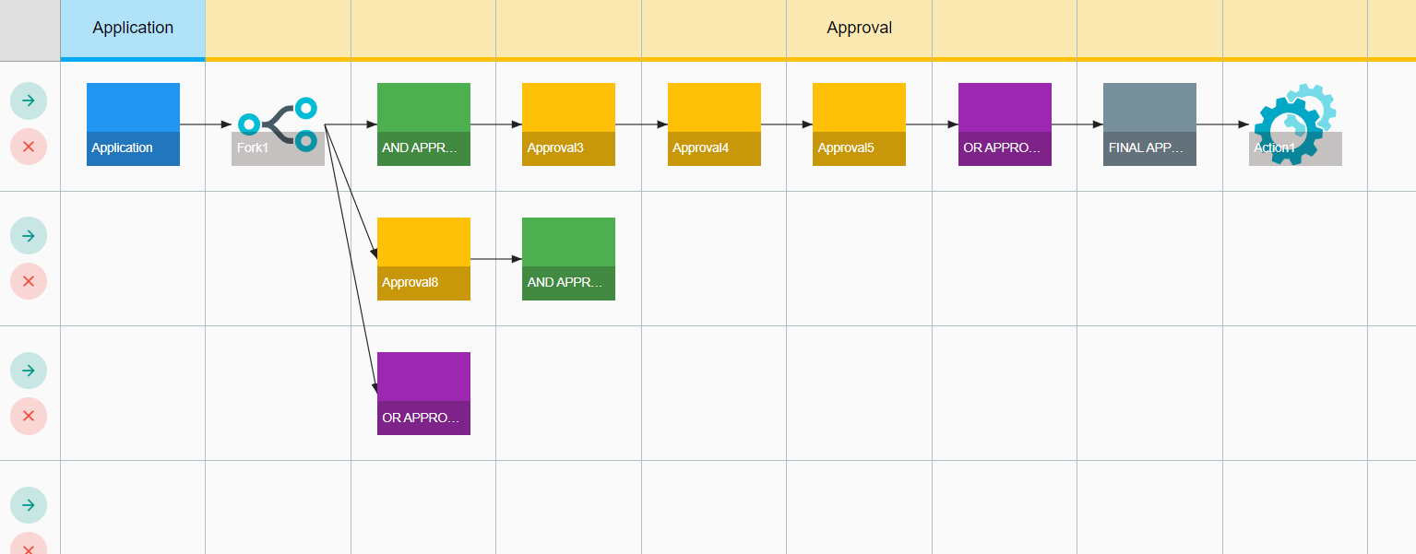
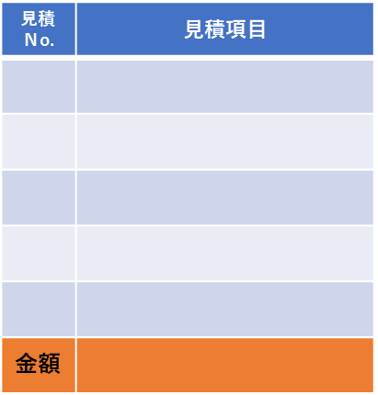
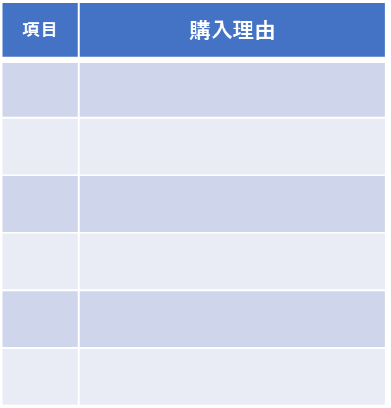
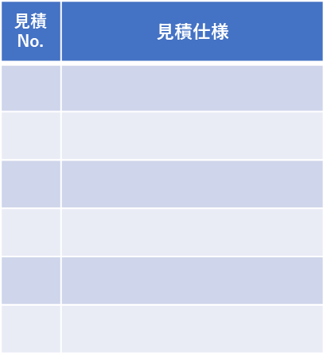
Mapping of approval workflows and form definitions
Layout of the approval workflow and indication of the approval cluster in the i-Reporter form.
AND Approval. All approvers and final approvers must sign off.
Transaction ID: 1234 | Transaction name: Server equipment purchase authorization form
Server equipment purchase authorization form P1
Server equipment purchase authorization form P2
Server equipment purchase authorization form P3
Server equipment purchase authorization form P4
Requestor
Requestor
Reviewer
Approver
1
Approval comment
Approver
Estimate
2
1 to 7 are all clusters within an i-Reporter form
Purchase reason
Estimate
3
Specify one cluster on the i-Reporter form to link with the approval workflow
4
The person filling out the form (requestors) and the reviewer are not part of the approval process.
5
Final Approvals
Final Approvers
6
TOTAL
7
12

Slide 13
Automatic triggering of approval requests
When the designated “approval cluster" in an i-Reporter form is filled and an application for approval is submitted, this triggers the application process within i-Repo WorkFlow and the approval process is started.
When an i-Reporter form is saved while being edited, i-Reporters webhook functionality can be set to notify i-Repo WorkFlow in real-time of the changes.

Slide 14
Updating of i-Reporter forms during the approval process
When a step along the approval process is completed, the cluster that is designated is automatically updated with the approval digital stamp.
Once all the steps in the approval process for a form are completed that is set up in i-Repo WorkFlow the form is automatically marked as completed.

Slide 15
AND/OR Approval Functions
AND Approval Function
Requires approval of all users in the approval group
How to set the person that can approve
How to select the individual’s user ID
How to specify the user group ID
OR Approval Function
Requires approval of one user in the approval group
Approval is required from one of the users from the approval group
How to select the individual’s user ID
How to specify the user group ID

Slide 16
Rejection
It is possible to reject a form for approval and send it back to a previous stage in the approval process
Display on i-Reporter form
Any approvals that are returned after the stage of rejection will be automatically updated to "Not Approved".
If the application for approval is sent back, all applications and approvals will be canceled

Slide 17
Application approval withdrawal
The applicant for the approval can withdraw the approval application by themselves
Withdraw all forms submitted for approval
Displayed on i-Reporter forms
All approvals are automatically changed to disapproved on the form.
The approval application is also canceled

Slide 18
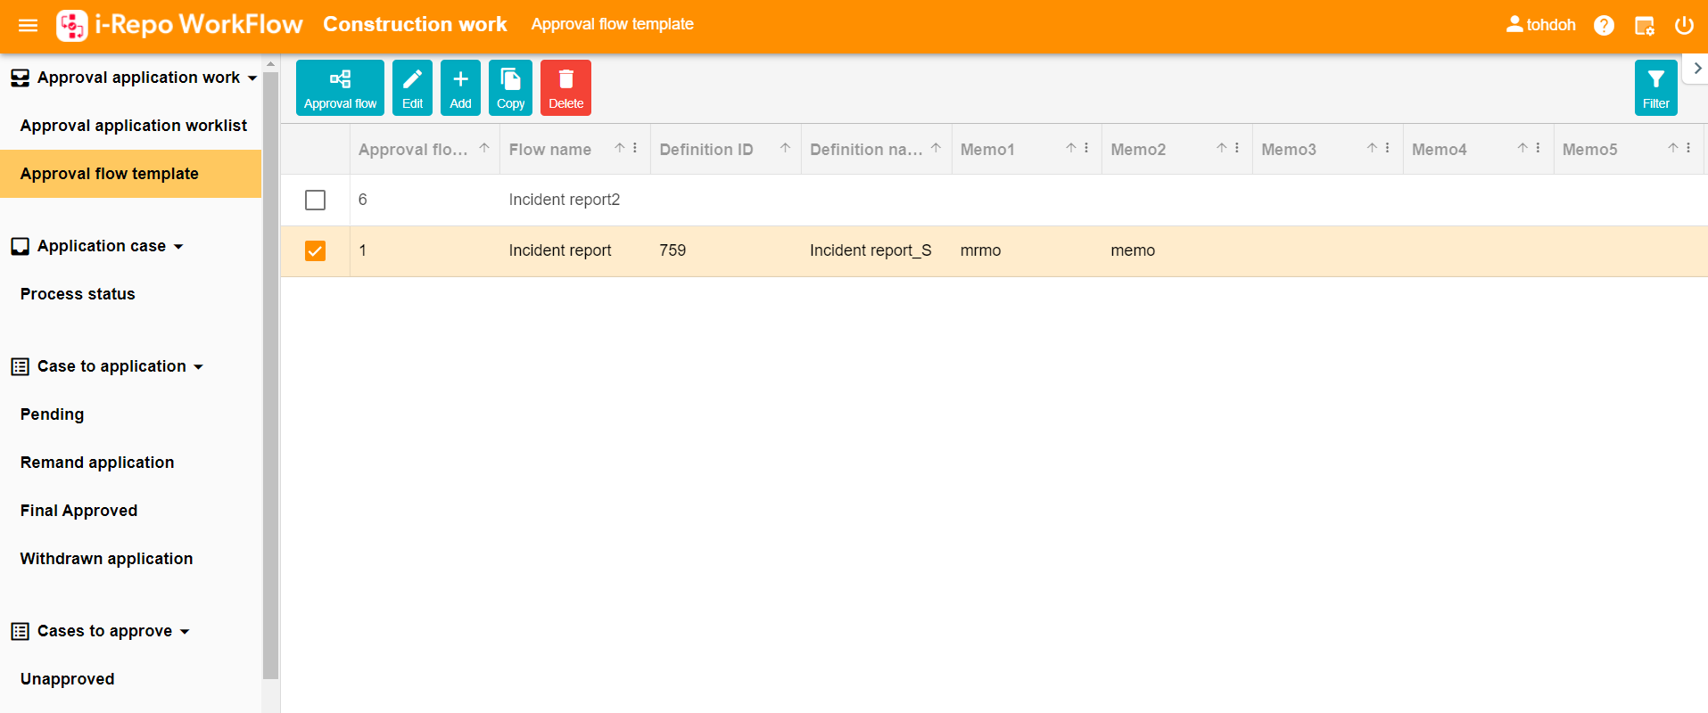
Listing of approval workflows
Selecting the target task displays the list of approval workflows associated with that task
Target task name
Display a list of approval workflows assigned to this task
To edit an approval workflow, select the approval workflow you'd like to edit and click the approval workflow button

Slide 19
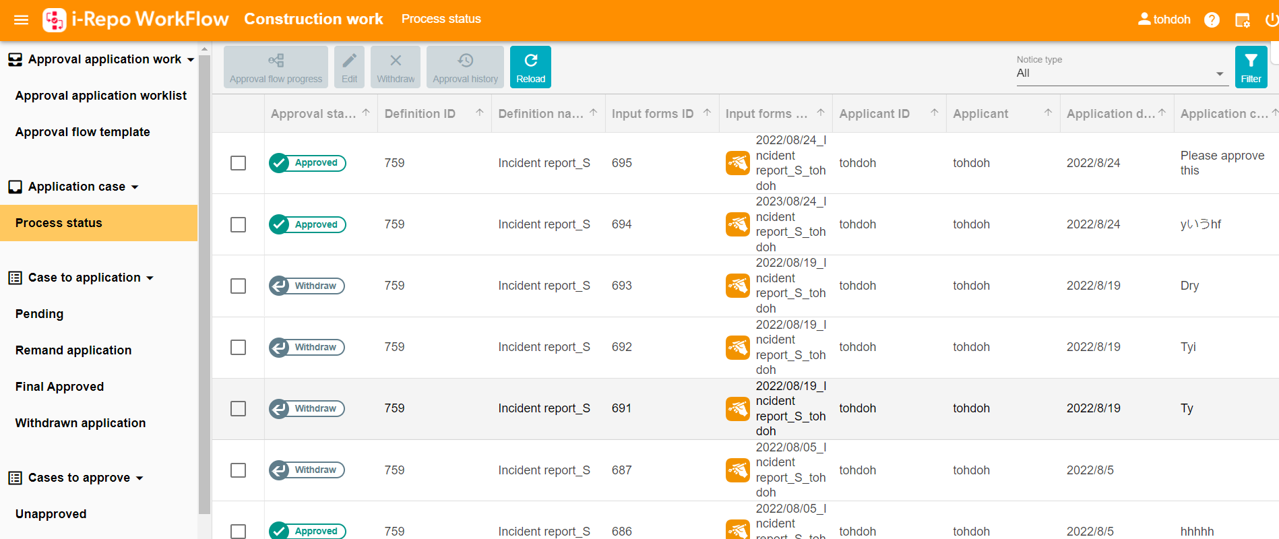
Display screen for checking the status of approval applications
Display of the status of approval applications
Target task name
Clicking on the "Approval Workflow" button with an approval workflow selected will display the progress in the approval workflow
Listing of approval applications for this approval workflow

Slide 20
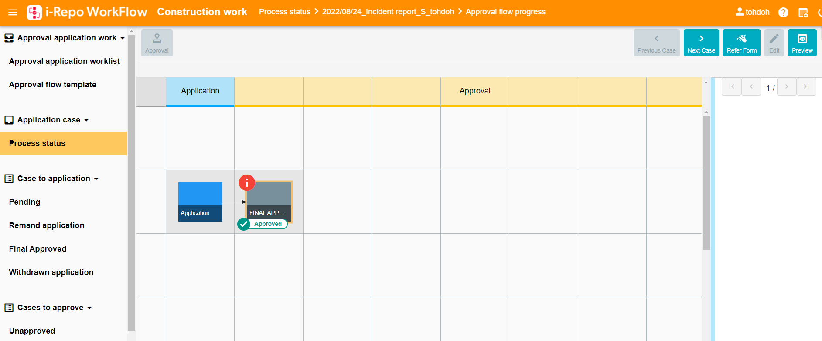
Checking the progress of an approval application in the overall approval workflow
Display of the current status in the approval workflow
Approval button
Icon displaying approval status

Slide 21
Comparison chart of i-Repo WorkFlow
Approval workflow settings by approval | ✅
Approval flow templates by forms | ✅
Flow branching according to input conditions | ✅
AND approval, OR approval | ✅
Imprint stamp/Handwritten signature | ✅ | ✅
Set the place of return | ✅
Withdrawal of application | ✅
E-mail notification | ✅ | ✅
Slack/Teams notification | ✅
Progress management of projects | ✅
Management of approval status | ✅
Application Request Management | ✅ | ✅
Approval Management | ✅ | ✅

