Slide 1

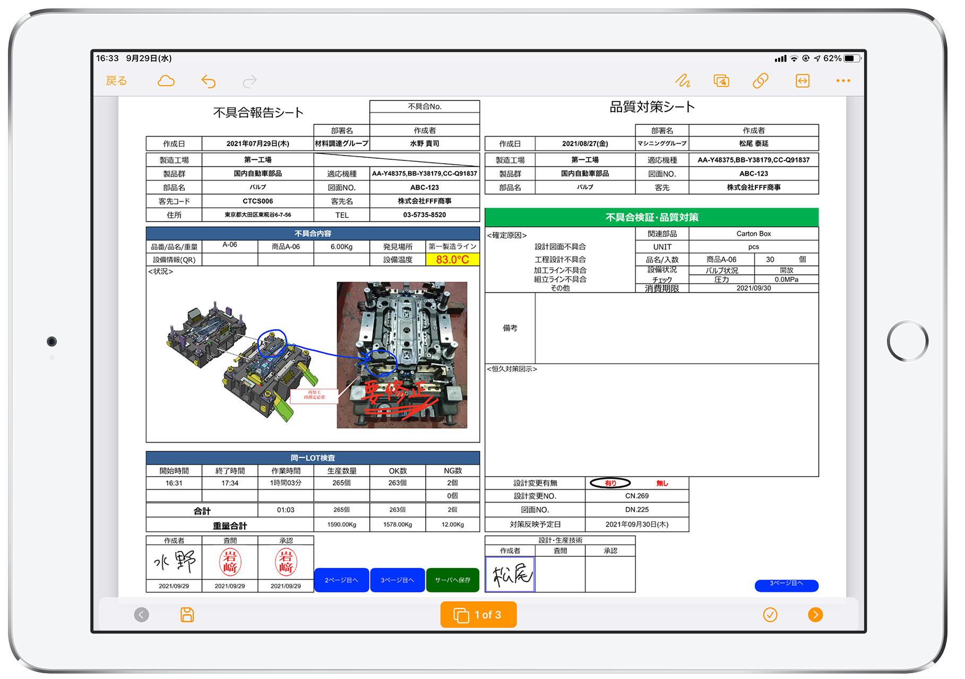
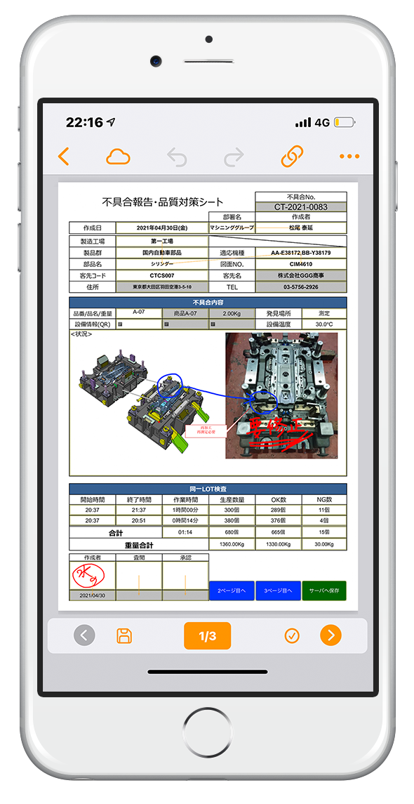



Recording, reporting and viewing solutions
Paperless 'work forms' that combine digital and manual input
Product Introduction
Rev.2018.V6.004
iPad
iPhone
Windows

Slide 2
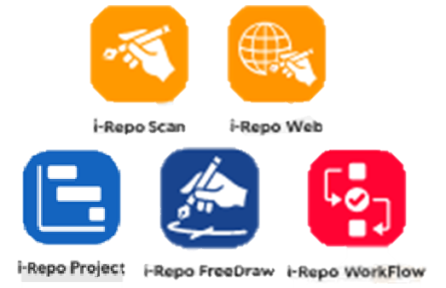



CIMTOPS Introduction
Established in 1991
Develops unique solutions specialising in on-site operations, with a focus on the manufacturing industry
Creation of unique and powerful packaged products that are unique and exclusive to CIMTOPS
For individual order production
Production scheduler + process control system
Paperless 'work forms'
Recording, reporting and viewing
BOP Process Editor
Multi Purpose Process Creator
i-Repo Family Products
(i-Reporter Options)
Our bespoke systems have been introduced and implemented by many manufacturers, mainly in the automotive and heavy industry sectors
Main
business partners
Toyota Motor Corporation, Toyota Motor Kyushu, Toyota Motor East Japan, Denso, Toyota Industries Corporation, Aisin AW, Fuji Heavy Industries, Honda R&D, Suzuki, Yamaha Motor, Tokai Rika, Daihatsu Kyushu, Anden, Bridgestone, Sumitomo Rubber Industries, Mitsubishi Heavy Industries, Toshiba, Mitsubishi Electric, Kawasaki Heavy Industries, Sumitomo Heavy Industries, Yazaki Parts, Kubota, YKK AP, etc.

Slide 3









The wide variety of functions offer peace of mind and reliability
Suitable for a wide range of industries
Responding to changing times and society
Supports a wide range of forms
Suitable for various company sizes
Support for various integration

Slide 4







i-Reporter Adoption
i-Reporter can be used for recording, reporting and viewing a wide range of 'on-the-spot' information in all industries, thanks to its diverse and versatile functions.
Manufacturing plants
Visiting dental and rehabilitation care
Safety patrols and construction checks
Inventory work in stockrooms
Shop patrol checklist
Damaged packages and abnormal goods in logistics warehouses
Maintenance and inspection service sites
Digitisation and paperless access to a variety of paper 'on-site' records,
reports and views in all types of industries

Slide 5
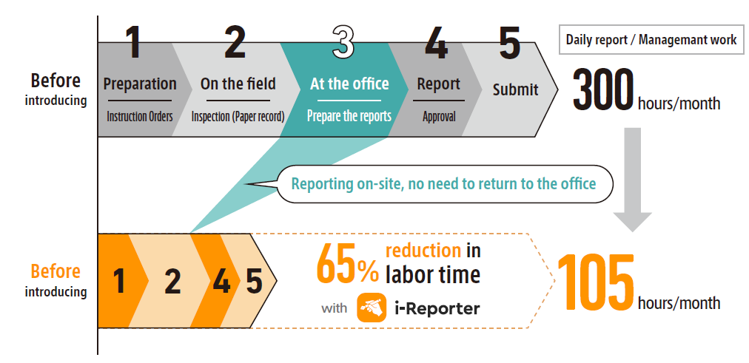
i-Reporter Implementation Advantages

Slide 6


i-Reporter Implementation Advantages
CASE 1
Paper forms are entered on site and collected at the office...
Are you experiencing a large number of post-processing man-hours in the office?
Hassle-free paperless transition!
Reduce all wasted time and costs associated with paper-based recording and reporting
A great deal of time is spent on post-processing tasks, such as filling in paper forms on site, taking photographs with a digital camera, preparing reports in Excel on return to the office, transcribing data for tabulation and entering data into internal systems.
Paper and Excel forms that you are used to using on a daily basis become electronic forms just as they are. Forms entered in the field are quickly digitised, eliminating the need for data entry back at the office. Storage of forms, printing costs and overtime work can also be reduced.

Slide 7


i-Reporter Implementation Advantages
CASE 2
Paper and Excel forms that you are used to using on a daily basis become electronic forms as they are. Forms entered in the field are quickly digitised, eliminating the need for data entry back at the office. Storage of forms, printing costs and overtime work can also be reduced.
Data entered on paper forms.
Are you experiencing errors and omissions with your data?
Paper forms need to be checked for errors and omissions.
In addition, there are further transcription errors during the computer input process, and a lot of work time is spent before they are digitised.
Various input methods, such as functions to prevent input omissions and errors, the attachment of photographs taken on site, and direct input from master data, QR code data and measurement data from Bluetooth-enabled measuring instruments, enable the creation of forms quickly and without input errors or omissions.
Hands-free and eyes-free voice input is also possible.

Slide 8


i-Reporter Implementation Advantages
CASE 3
Working with paper forms:
Hindering the efficiency of operations and sharing of information.
Is it taking a long time to share information?
Streamline operations with field-complete reporting, speeding up information sharing.
It also improves work quality, information accuracy and relevancy.
The process of scanning and digitising forms before utilising the information on paper forms that have been entered onsite.
Lead time to application, costly in time and effort to search for data from completed past paper forms.
Reporting and recording work can be completed on site, massively improving operational efficiency and speed by reducing post-processing work. As soon as forms are uploaded to the server from the field, they are immediately converted into data and shared in real time between the field and the office. Historical data can also be searched and referenced. Easy integration with external systems and quicker data utilisation.

Slide 9


















作業支援情報
作業を行うために必要な各種の生産支援情報を参照することができます
PDF図面
動画
Reference & Playback
3D Models
Office Documents & Images
i-Reporter Adoption Flow
Work support information
WEB Page
PDF Plan
Video
3D
Models
Office documents and images
Automatic email Transmission
Automatic integration with external systems
Reference and playback
Approval
Reference
Entry
Reference
Output
Approval
Collection
Entry
Production &
Quality records
Shop patrol checklists
Safety patrols
Home health care &
Rehabilitation healthcare
Facilities & equipment
Maintenance and inspection
Inspection records
Defect reports
Daily work performance report
Equipment inspection check
Equipment inspection checks
Road inspection checks
Shop checks
Hygiene checks
Safety checks
Patrol checks
Medical Questionnaire
Dental record
Pre-admission status survey
Form database

Slide 10
i-Reporter Features
Provides a completely new style of 'on-site' recording, reporting and viewing that combines digital and manual input using iPad, iPhone and Windows.
1
2
The familiar paper and Excel forms become electronic forms on the iPad as they are.
Digitalisation and paperless forms, retaining the quality of handwritten paper forms.
Centralised management of all forms in the forms database.
Easy automatic integration with other back-end systems.
3
4
Powerful functions & light, fast operation via iPad native apps.
Can be used in offline environments where there is no signal.
With the document management function related documents such as drawings and procedure manuals can be viewed at the same time.
Digitisation of manual based paper work that has been impossible until now!
improves the efficiency and quality of operations, speeds up and reduces costs.

Slide 11





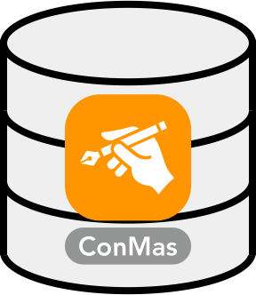

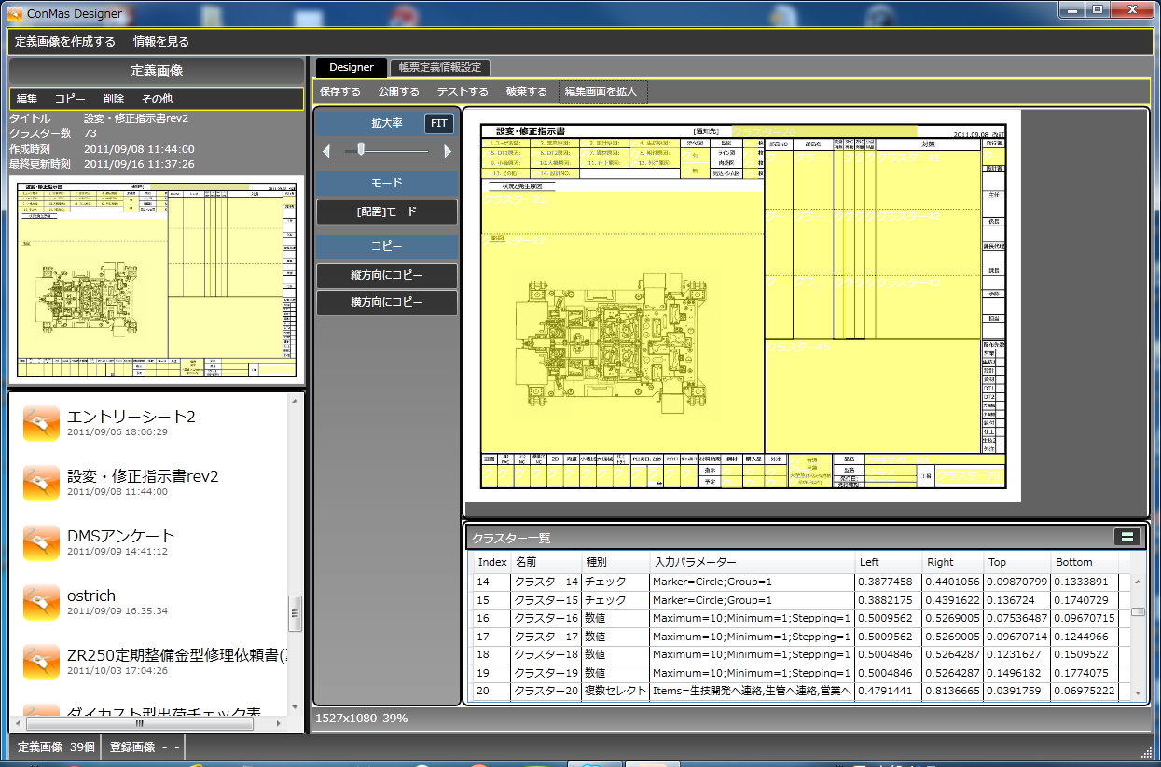


i-Reporter Configuration
ConMas Server, ConMas Manager, ConMas Designer and i-Reporter apps (iPad, iPhone and Windows)
The system consists of four
ConMas Manager
Referencing and editing of forms, system administration
HTTP/HTTPS
(REST)
ConMas Server
Referring to and creating forms and viewing related books on iPad, iPhone and Windows
Edge
Chrome
Form Database
Safari
Web Application
ASP.NET
ConMas Designer
Windows Server System
Microsoft.NET
PostgreSQL
Data Base
Individual Authentication Management
Design of form sheet definitions
HTTP/HTTPS
(REST)
Login and password
management
256-bit SSL-encrypted communications
HTTP/HTTPS
(REST)
User, rights and authority
management

Slide 12




i-Reporter Case Studies
Monthly: 300 hours 130 hours
60％ Reduction
Approximately 25% less work per day
Sekisui Sheet Molding Industry Co., Ltd.
TODA CORPORATION
Daily production reports were digitised using i-Reporter.
This initiative won a silver award in an improvement contest within Sekisui Chemical Group companies.
Since i-Reporter has been used on their construction sites, the workflow for creating forms has changed dramatically, leading to a reduction in labour costs.
Details of these case studies can be found on each product website

Slide 13
Features and main functions

Slide 14
Apps for iPad, iPhone and Windows tablets
The field worker can input data easily, without fuss and without error with a focus on easy-to-read, easy-to-understand forms.

Slide 15


Digital input for easy and accurate data entry
32 types of digital input are available for ease of input and accuracy according to the type of input data
Manual input on paper forms leads to variations in input by individual workers, misinformation, mistakes, etc. reducing the quality of the work.
Correct values cannot be collected or there are enquiries and requests for correction afterwards, leading to a waste in time and costs.
Intuitive, dedicated digital inputs to solve these problems.
See here for more information on the 32 different digital inputs
https://i-reporter.jp/en/functions_cat/form-input/

Slide 16

Input from 1 dimensional barcodes and QR codes
Barcode scanning reduces input effort and helps to ensure accurate and correct data entry.
Can be read by the tablet/iPhone's built-in camera and Bluetooth-connected recorder.
Form Searching
Text Entry
Login ID
Quickly search for forms by reading barcodes and QR codes in the search window of the form sheet library
Text entry via barcodes and QR codes
Enter login IDs such as employee ID cards by reading barcodes and QR codes.
1D barcodes and QR codes can also be input from external barcode readers via Bluetooth connection.
Depending on the barcode reader model, an OCR function is also available to read and digitally convert text.
It is possible to read the barcode or QR code of the part number on the shelf and find the stock inventory form issued by part number in the server's form library.

Slide 17
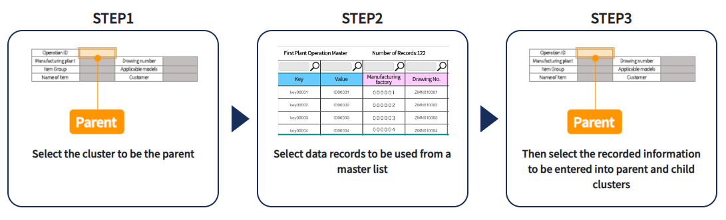
Custom Master
It enables easier, error-free and quicker entry of many input fields
With a custom master, selecting a value for one input item can be used for several other input items related to it. The values registered in the master can be automatically entered in one shot.
Automatic data entry of custom masters on tablets

Slide 18
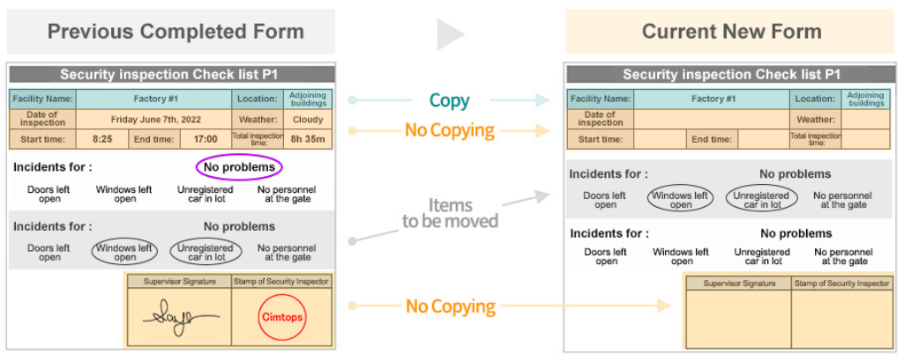
Batch downloading and uploading
Batch downloading of forms and form definitions to be worked on the same day from the server to the terminal in an online environment.
Batch uploading of forms temporarily stored on the terminal to the server after returning to the online environment after working in an offline environment.
(After uploading, the forms in the iPad storage are automatically deleted.)
Checks for omissions of required items in each form during batch upload.
Data containing errors are not uploaded and a reason is displayed.

Slide 19
Access to drawings, procedures and other relevant documents
While recording and reporting on site, relevant drawings, procedures and other documents can be viewed at the same time.
Work support information
Various production support information needed to carry out the work can be checked.
WEB Page
PDF Plan
Video
Reference & Playback
3D Models
Office Documents & Images
Inspect while typing

Slide 20
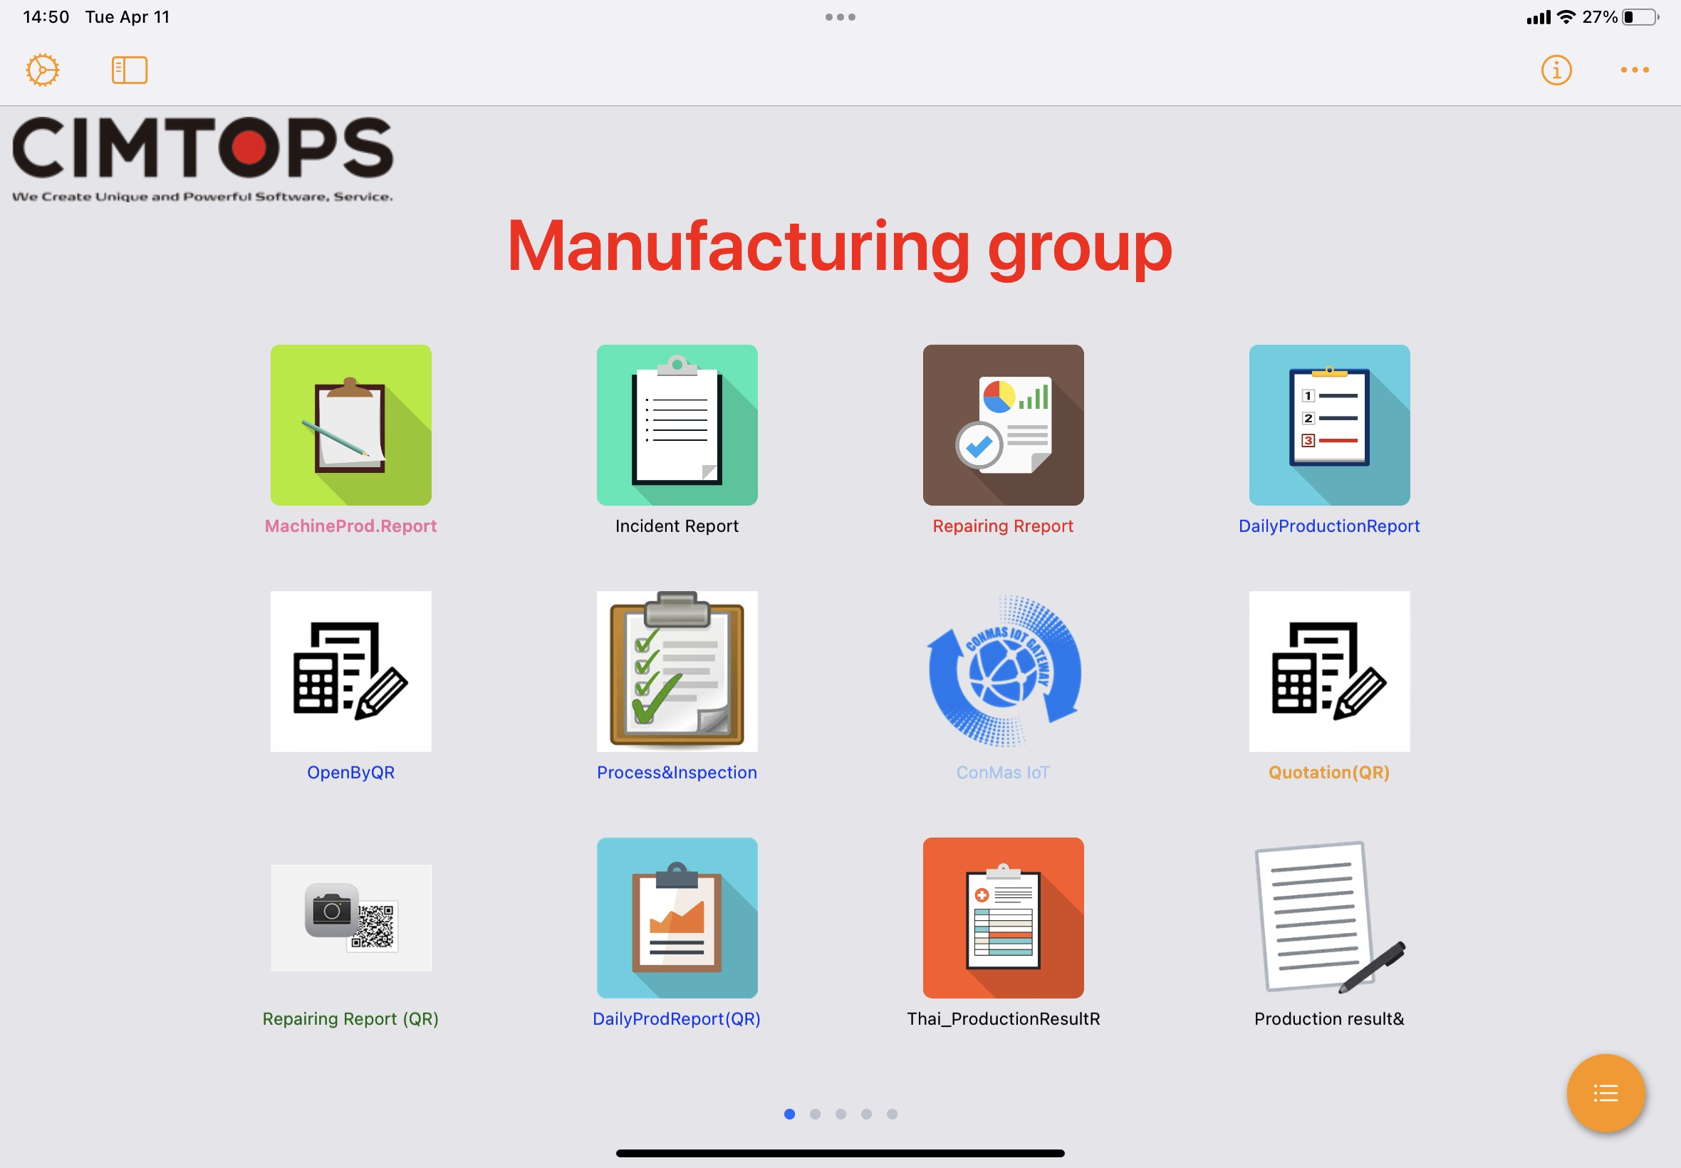
Custom Menus
Custom menus can be set up for easier, error-free and quicker input.
Utilises custom menu functionality so users can set their own screens and distribute them to devices
Barcodes, QR codes, iBeacon, NFC, etc. can be read by specified devices and automatically dispatch forms.
Set logo image
Menu Title
Menu button images and button names can also be customised

Slide 21
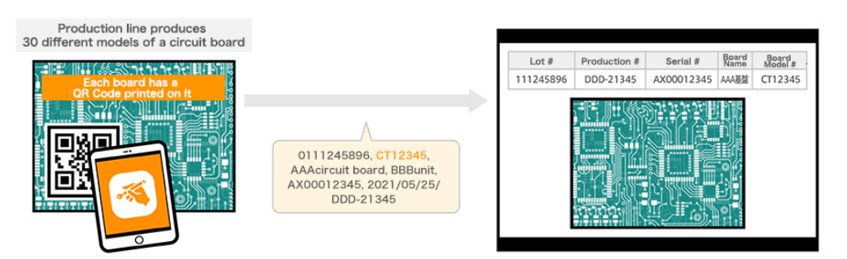
Custom Menus work example
Printed circuit boards with QR affixed.
By scanning the QR code during the inspection process, users can find an inspection form specifically for that model from more than 30 different types.
Search for the form definition to be used by board reference number for easy recall.
Disassemble QR code data, carry out automatic batch input and launch the form

Slide 22
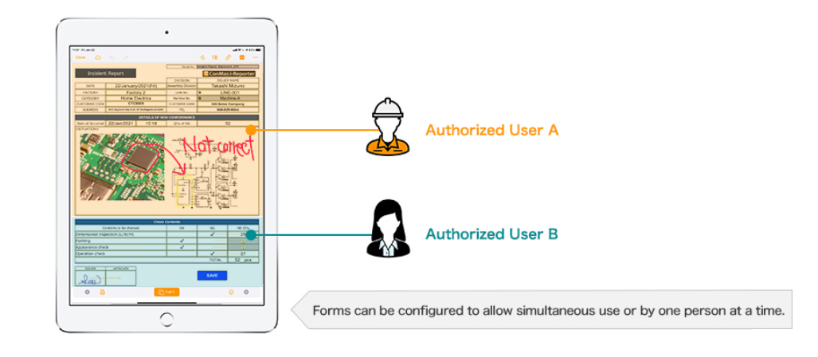


帳票定義ごとに同時編集をする／しない設定が可能です
Simultaneous editing of forms by multiple users
User A
User B

Slide 23
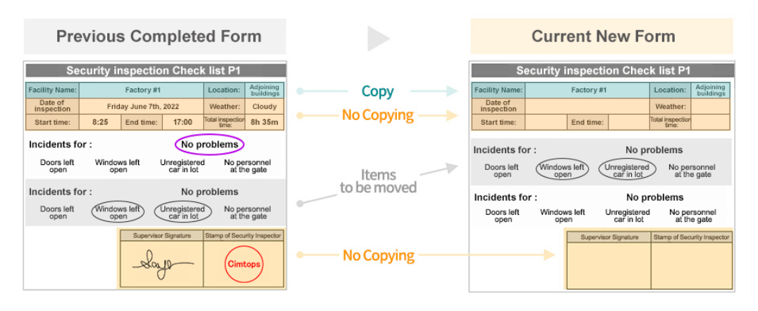
Copying and creating existing forms
The Manager app can copy existing input forms to create new input forms
This function allows you to create a new input form using the information from a previous form that has already been input.
This is useful, for example, when a new inspection is carried out using the results of a previous inspection.
Copy
Don’t copy

Slide 24



Preparation, review and approval stamped and signed
Even reports with stamped fields for creation, review and approval can be digitised as they are, with approval routes set up.
Signature
Seal
Author
Seal
or
Signature
Reviewer
Seal
or
Signature
Approver
Seal
or
Signature
section chief
factory manager
The following information is stored with the image data of each stamp and handwritten signature
User IDs of authors, reviewers and approvers
Date and time of creation, review and approval
Name of author/reviewer/approver
Comments during creation, review and approval

Slide 25

Custom URL schemes
Implementing mechanisms to work with other apps on iOS/Windows
The i-Reporter application can be launched from a web browser business application
When starting the i-Reporter application,
it is possible to specify the start-up behaviour by passing parameters
Launch i-Reporter
Creation
Editing
External
Applications
Parameters make it easy to create and edit the specified forms at the same time as the application is launched.

Slide 26

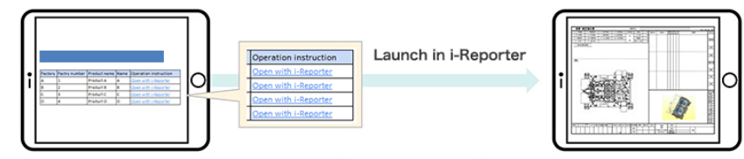
System construction using custom URL schemes example
Work order creation CSV
Form ID: 1
Form ID: 3
Response (form ID)
ConMas Web API
ASP.NET Web Application
Form ID: 2
Form ID: 4
The form IDs numbered by i-Reporter are returned and retained for the parameters of the custom URL scheme.
Creating forms with the automatic form generation API
Generate embedded construction numbers, part numbers, work numbers and other necessary information.
Retrieval
Embedding a custom URL scheme link tag in the page using the i-Reporter form ID linked to the business system data as a parameter.
After launching with a custom URL scheme, the specified form can be linked to the business application by opening it in edit mode based on the form ID in the parameters.

Slide 27
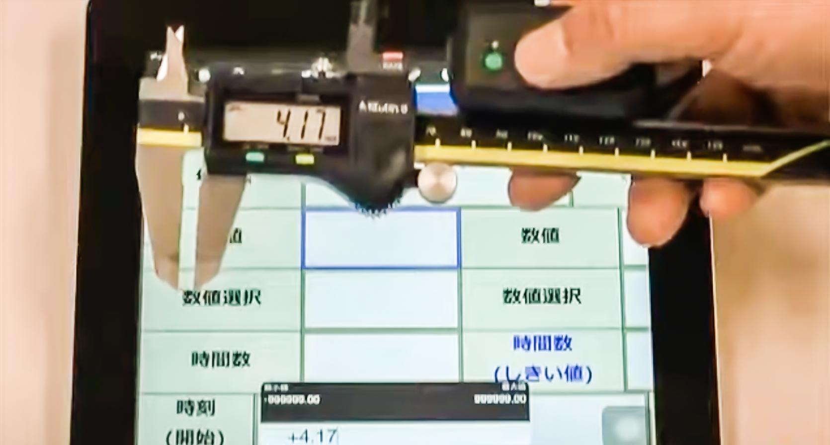


Data input from measuring instruments
Measurements can be input directly from various measuring machines using the DKA-102 (from Digitech).
This video shows an example of the input using the DKA-102
https://youtu.be/i6zQEOdGZW0
DKA-101/102 List of connected and verified measuring instruments
Click here to see the integration results
※ DKA-101/102 is supported in Japan market only due to the radio frequency regulation.
Please confirm the available digital tools in your country.

Slide 28
Easy Design of Form Screens
ConMas Designer
Familiar Excel forms can be converted directly into electronic forms. Users can easily change the layout of forms and add items after the start of operation using Excel.

Slide 29
Electronic forms can be created directly from familiar Excel forms
PDF and image forms can also be turned into electronic forms
The familiar forms you use every day become electronic forms, so anyone can use them intuitively and immediately from the day they are introduced
Theres is no need for operational training!

Slide 30
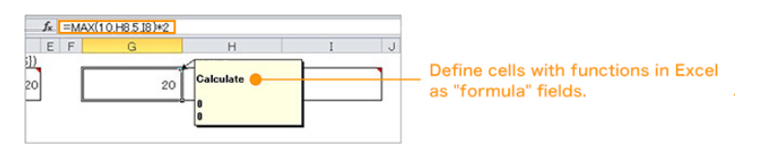
Support for Excel functions
Total
Two types of Excel functions can be used without modification
SUM
MAX
MIN
AVERAGE
STDEVP
ROUND
IF
Excel definition of cluster type as "formula". Excel functions written for the set cells are ConMas functions and set automatically.
Excel functions can also be combined with four arithmetic operations

Slide 31
Form Management and System Management
ConMas Manager
We have prepared essential features in the system to directly replace the daily field operations that were previously carried out using paper-based forms

Slide 32
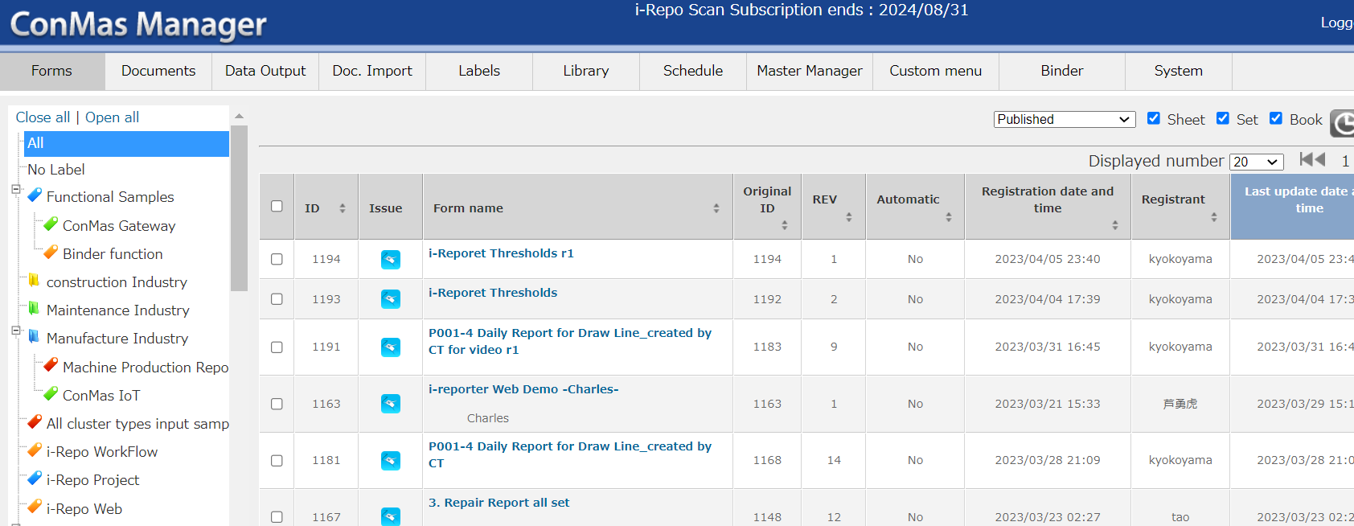

Centralised management of forms data
We centrally manage business forms that have been traditionally paper-based, and streamline on-site form-related tasks for improved efficiency
Formwork definition
Browse and edit forms
Data output
Automatic Form Generation
Label management
Document management
Schedule management
Systems-management
System menu
Label list in report tree format
Filtering by report status
Tabular list view of reports belonging to selected labels
Viewing and editing on web browsers of PCs, tablets, and smartphones

Slide 33





Form management by labels
Forms and other items can be easily classified and managed by users using parent-child settable labels for better organization
Only the labels for which the logged-in user has viewing permissions are displayed in Manager, Designer,
and the entire application.
Labels can be set separately for forms and documents
You can freely assign names to labels
You can establish parent-child relationships between labels
You can assign an unlimited number of labels to a single input form or document
Example of setting parent-child labels
Manufacturing results for April 2021
Manufacturing Department 1
Manufacturing Results
Inspection Records

Slide 34
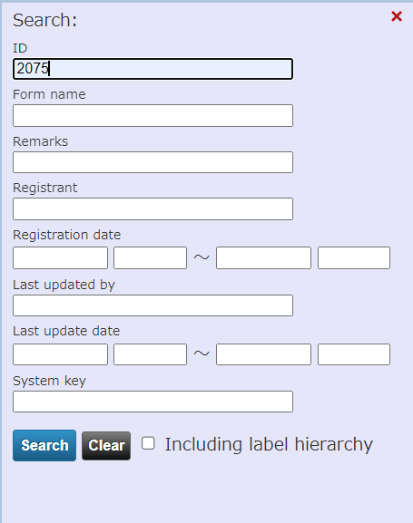
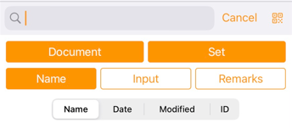
Form search and sorting
With ConMas Manager and the application, you can easily search for specific reports from a large number of forms in the database.
Search, filtering, and sorting are all possible.
In the search and filtering value input window within the application, searching by scanning barcode or QR code is possible.
During search, reports that are included under labels lower in the hierarchy than the selected label are also included in the search results.
Targets for Search and Filtering
Publication Status
Form Type
Form Name
Label Name
Input Value
Reference
Sorting Target
Form Name
Registration Date and Time
Update Date and Time
Sort Order (Ascending/Descending)

Slide 35
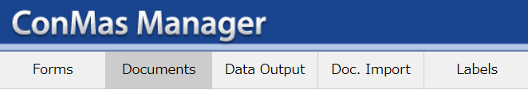

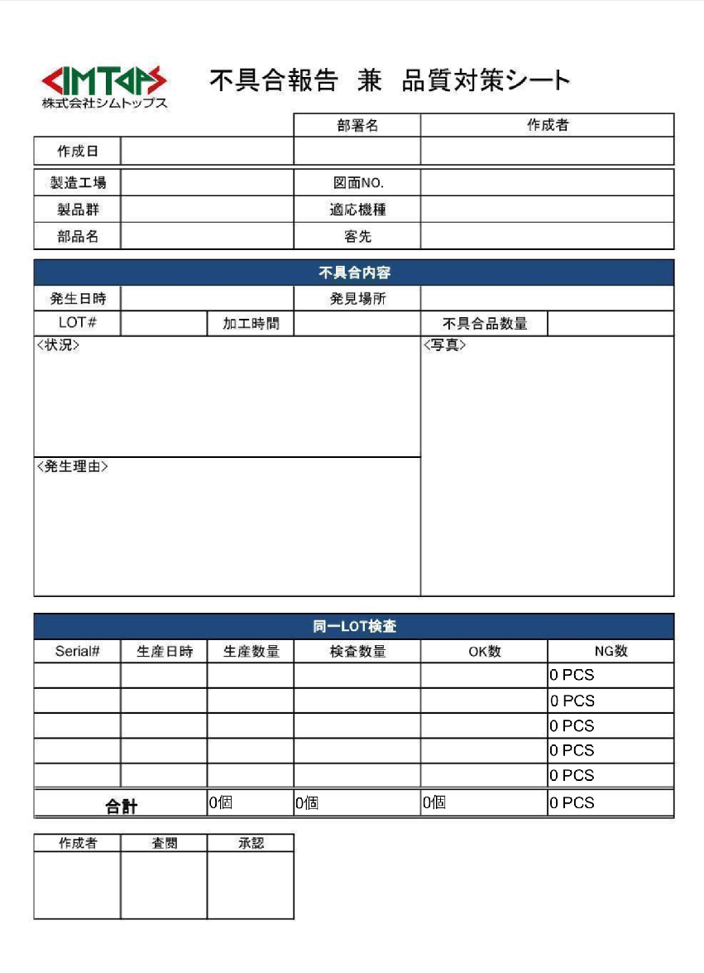
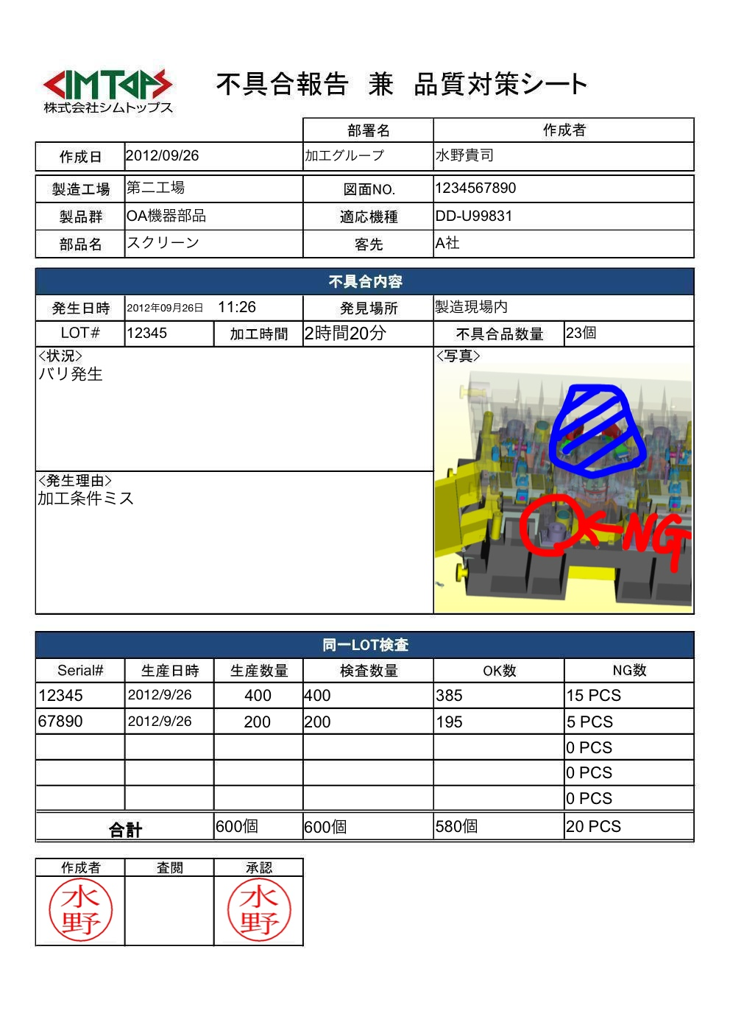
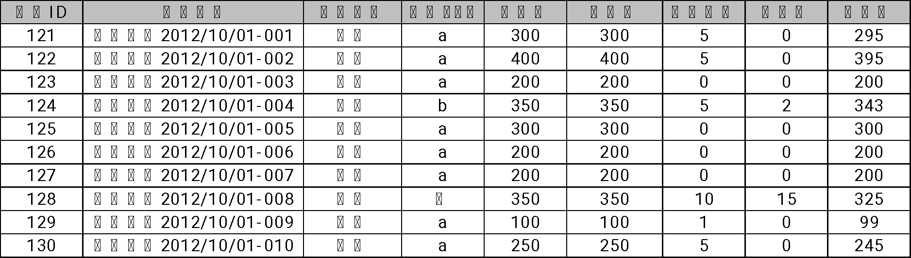
Bulk CSV exporting of form input data
By bulk exporting the input data of multiple reports created from a single report definition to CSV format, it becomes possible to easily aggregate and analyze data using tools such as Excel.
Multiple output source forms can be specified.
You can choose which field to output
for each forms.
It is also possible to output input image files and PDF files of reports simultaneously
Form A
Documents created
from form A.
Specified cluster
Batch output

Slide 36
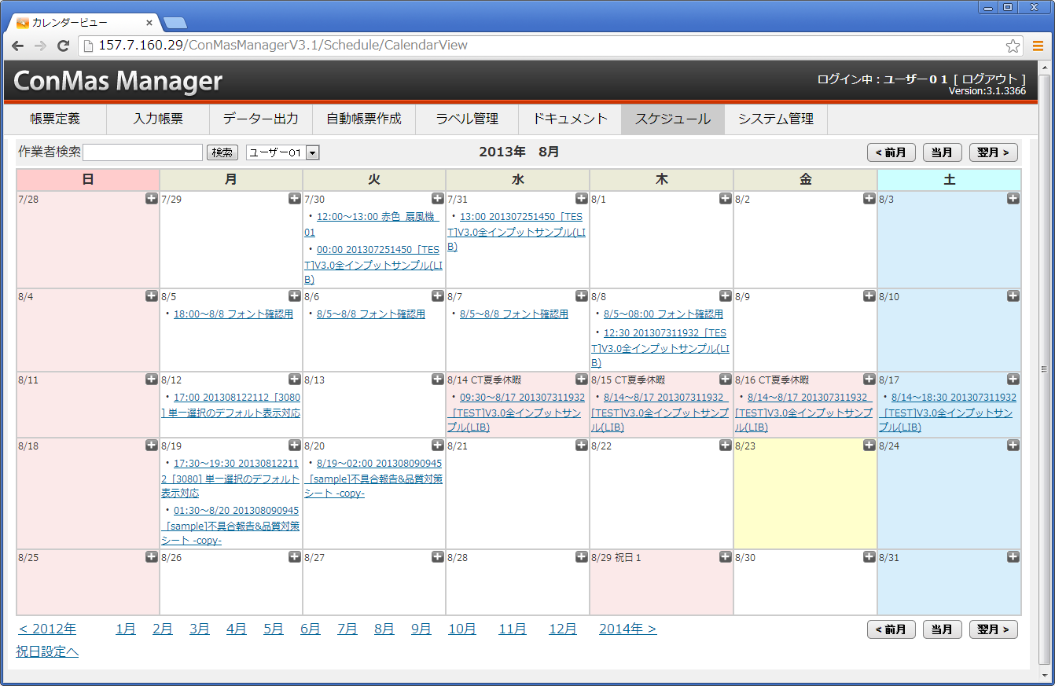

Schedule management function “Schedule Manager”
Managers can create work schedules for the field and send instructions to devices
Managers can create work schedules in ConMas Manager's user-specific work registration calendar screen, specifying "who," "when," and "what" tasks to be performed, along with the use of which report.
Manager
on-site
Work registration calendar screen

Slide 37
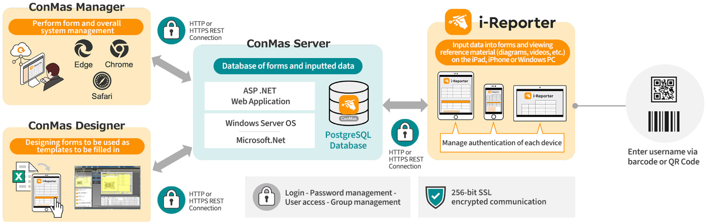
i-Reporter system configuration
When accessing ConMas Server, user authentication is required by inputting a login ID and password. This is to ensure that only authorized users can access the ConMas Server system and its data, and to maintain security of sensitive information
User authentication in ConMas Manager (browser)
User authentication in Designer (Windows client)
In the app, barcode/QR code can be used for input of login ID

Slide 38
Password strength settings
Password strength validation during user password setup where the strength of the password is checked based on the configured settings. If the password strength is insufficient, the setup will not be completed
Check items that can be set (multiple selections possible)
Include upper and lower case letters
Include a number
Include symbols
The password must contain 'uppercase letters (A-Z)' and lowercase letters (a-z)
You password must include numbers (0-9)
The password must contain symbols
Number of password digits
Do not use the same password as last time
Setting password expiry dates.
The password must be at least the minimum number of digits set
You need to set a password that is different from the one previously set
When the password expires, you need to set a new password again

Slide 39
Individual device authentication management
Access to the ConMas Server is only allowed from devices that have been individually authenticated by the server
Register the "Server Connection", "User ID", and "Password" in the settings screen of the app
You log in to the server from the device before authentication
From the "Device Authentication" in the app's settings screen, you can submit an "Approval Request" by entering a comment in the application screen and submitting it
The app sends both the "Device Identifier (UUID)" and the "Applicant Information" to the server simultaneously (the app retains the "Device Identifier (UUID)" internally)
In ConMas Manager, you can approve iPad devices with "Device Authentication" requests from the "Device Management" menu
ConMas Server allows access only from devices with approved "Device Identification UUID" for accessing ConMas Server

Slide 40
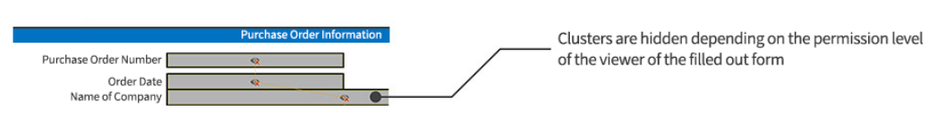
User and permission management
You can set permissions for report definition and report access/editing
You can manage permissions through individual (user) accounts, permission groups, and roles
(access permissions)
You can configure different settings for report definitions and the input reports created from them
Roles for form definitions
Form definition unit
Reference
Deletion
Newly created
Editing
Form roles
Form unit
Newly created
Editing
Reference
Deletion
Roll for each input item unit of the form
Input-output item unit
Newly created
Editing
*Items that are not to be shown in the form can be masked

Slide 41
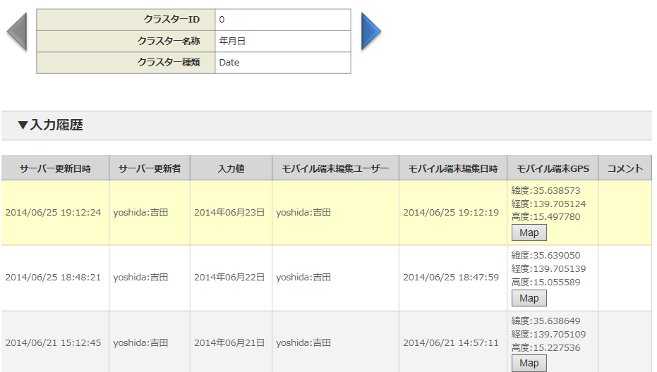
Correction history management for each input item
Whenever each input value in a form is updated, the input value information is retrieved as a history, and the entire history of input values can be checked for each input item.
The input history is saved on the server, not locally on the iPad or iPhone.
There is no limit to the number of input histories.
It is possible to set whether or not to acquire history for each form definition (system-wide settings are also possible).
Stores the cluster's input values as history each time it is saved to the server.
(The number of histories varies from cluster to cluster).
Server storage
Or
Completed process to server
Cluster A
Current Value
Previous Value
Class A
The previous previous value
You can check input trends and who edited what and when
Cluster B
No history is set when saving locally.
Current Value
Class B
Previous Value
The previous value can be checked even if the input value is changed midway

Slide 42
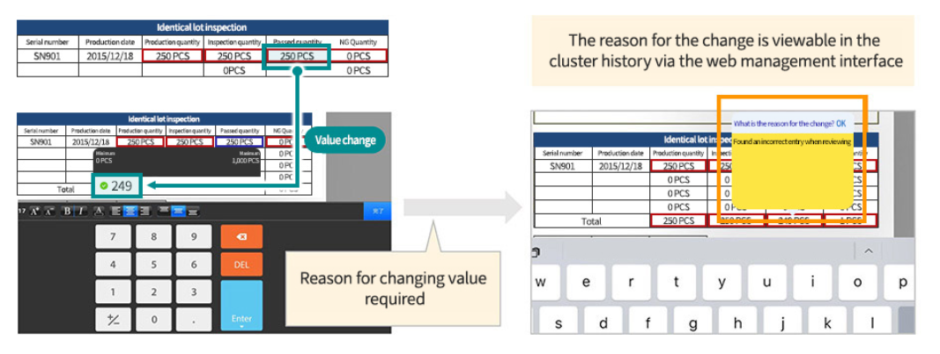
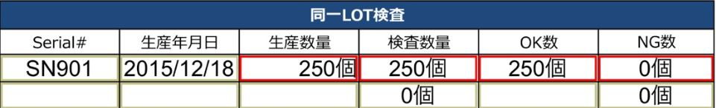
Enter reason for change of cluster value
When changing a cluster value once it has been saved on the server, the reason for the change can be entered each time
If you do not enter a reason for the change, you will not be able to change the cluster value
This setting is done in Designer for each form definition or in Manager for each form definition or form
Change value
You will be asked to enter the reason for the value change

Slide 43
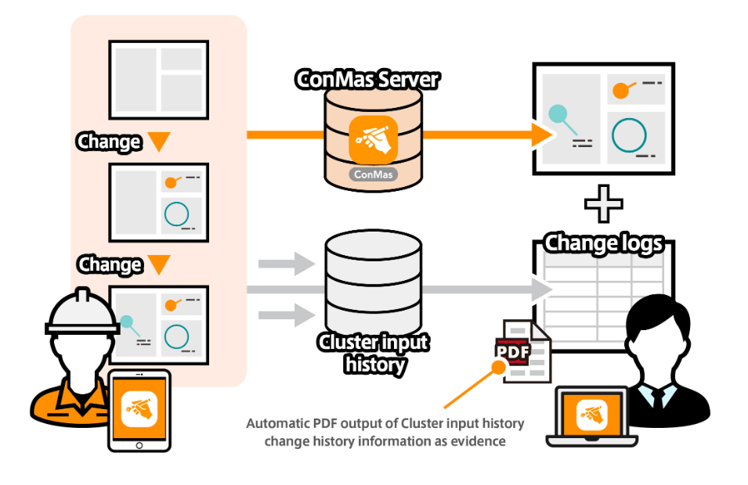
PDF trail output
Automatic additional 'Change History' pages can be export as PDF trails when exporting PDF forms

Slide 44
Integrating Data With Other Systems
Easy automatic data integration with external systems such as hosts, off-computers and ERP, Zero post-input man-hours

Slide 45
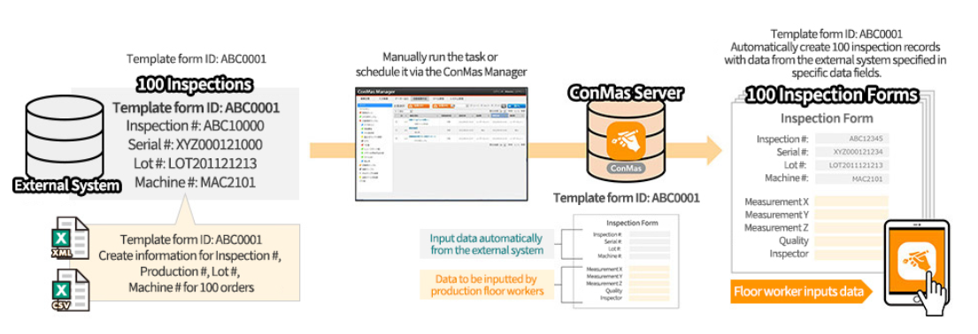
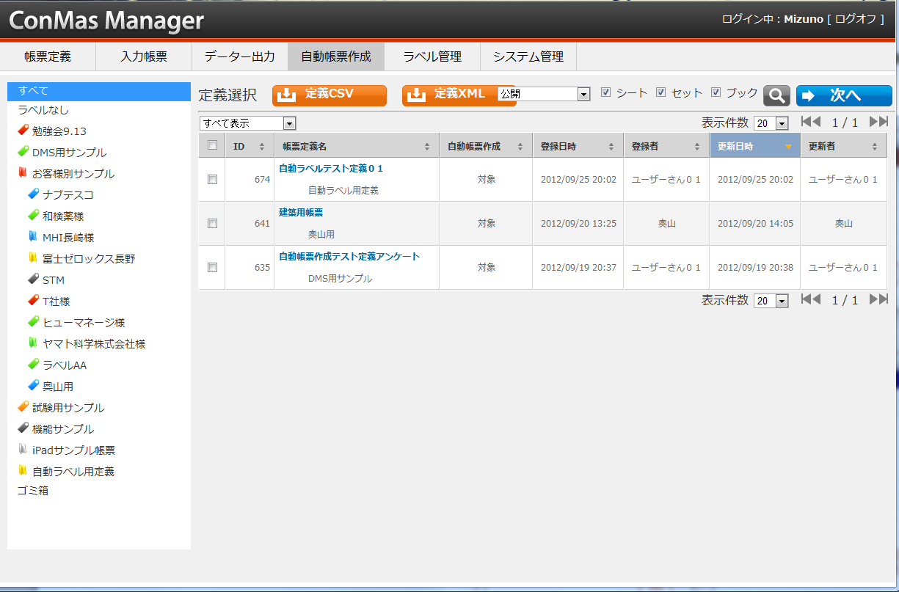
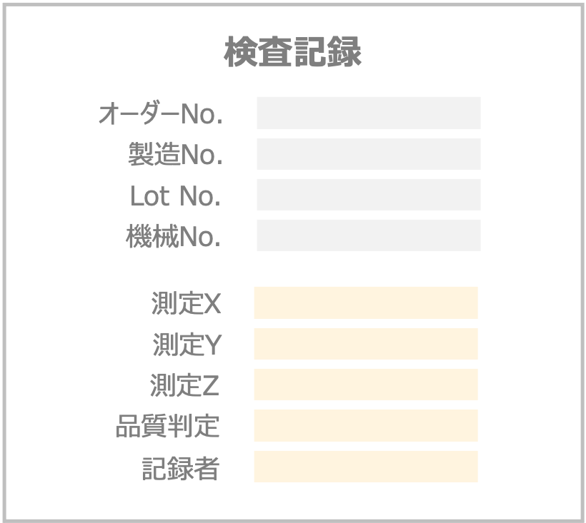
Creation of forms with data plugged in.
The large number of input forms required on a daily basis can be easily created from the menu, eliminating the burden of creating forms on site
Information output and created from external systems is imported from ConMas Manager and inserted into several specific clusters within a form to create a form.
You can also register your schedule at the same time
Form definition ID: for ABC000
Manual execution from the Create menu leads to Automatic forms in ConMas Manager
Form definition ID: ABC0001
Input items automatically set by the higher-level system
Form definition ID: ABC0001
100 forms for 100 inspection records
Order No., Production No., Lot No. and Machine No. information for 100 inspection records.
Items to be entered on site by operators.
Input via app.

Slide 46




Automatic data output of completed forms
When a form is processed to completion, the following sets are automatically
output per form to the specified directory
The file to be output can be specified for each form definition
CSV data entered in forms
XML data entered in forms
Image PNG of the form
PDF Form
Excel Form
Comment text and photo images in FreeDraw.
(only if the form definition was
created from an Excel file)
By developing a monitoring-type programme for a specified directory on the server, form sheet data can be automatically retrieved and linked to external systems.
Monitoring type programme for specified directories
Output to a specified directory in the server.
PNG
Form PDF
Form Excel
XML Files
CSV Files

Slide 47
Web API Integration
The ConMas Web API enables external system programmes to call various APIs and access all information in the ConMas DB in real time
Web API List
ConMas Web API
Log in
Log out
Definition list acquisition
Definition acquisition/registration/deletion
Definition lock acquisition/release
Permission information acquisition/setting
Label information acquisition/setting
Reference information acquisition/setting
ASP.NET Web Application
Automatic form generation
Selection value information update
Deletion of forms
Definition deletion
Batch download of forms
ConMas DB
Web Client
Example
external import application
User information registration
Group information acquisition
Group information update
User information acquisition
Common information acquisition
Common information update
Terminal acquisition
Acquisition of new form sheets
Obtaining a list of form sheets
Retrieve/register/delete form sheets
Acquisition/release of form lock
Obtain/set consultation information
Label information acquisition/setting
Reference information acquisition/setting
REST commands (login)
A command reference and .Net (C#) sample code are provided to implement WebClient functions, including the browser
POST
REST commands (to obtain forms)
POST
External System Data
REST commands (registration of forms)
POST
REST command (logout)

Slide 48
Publication of externally referenced views
A reference view is available for external systems to retrieve all information in ConMasDB
It is possible to connect to the ConMas database PostgreSQL and retrieve all form definition information, form information and master information from the view for reference.
※An environment that can connect to PostgreSQL DB is required. ※It is not possible to add, change or delete information in ConMasDB (only reference is possible)
Definition information reference view
Form information reference view
Master information reference view
Form top definition view
Sheet definition view
Cluster definition view
Definition authority view
Definition cluster authority view
Definition reference document view
Definition label master view
Definition label view
Definition form label view
Forms top view
Sheet view
Cluster view
Form authority view
Form cluster authority view
Form reference view
Form label master
Form label view
User master view
Group master view
Group affiliation master view
Terminal master view
System Settings View

Slide 49


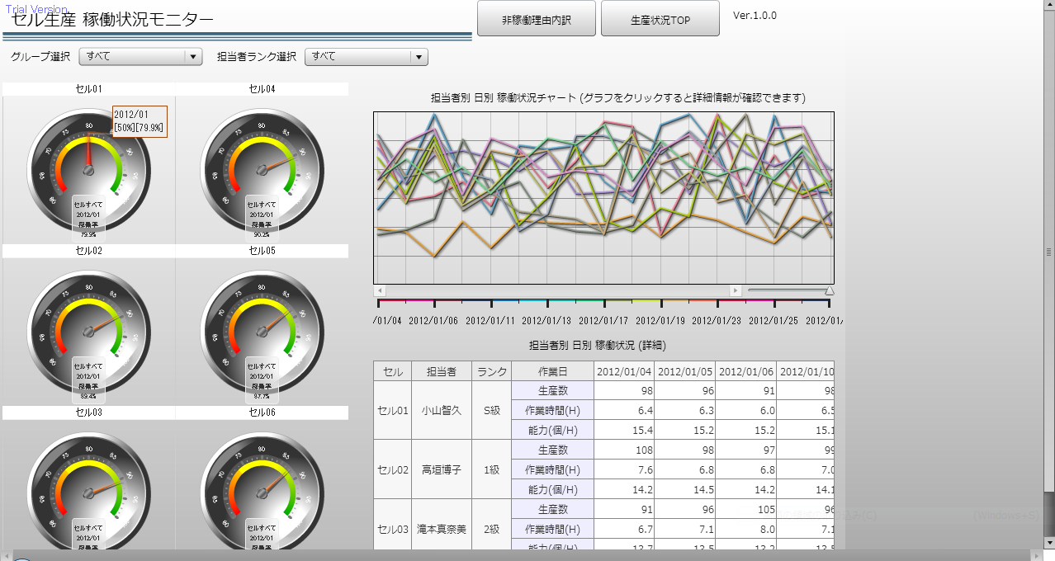
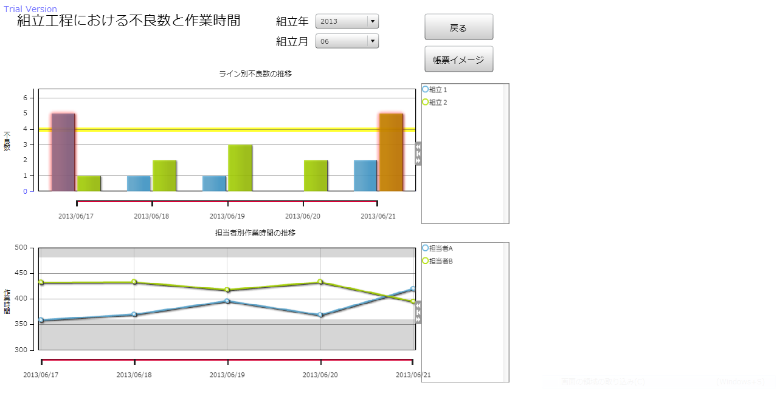
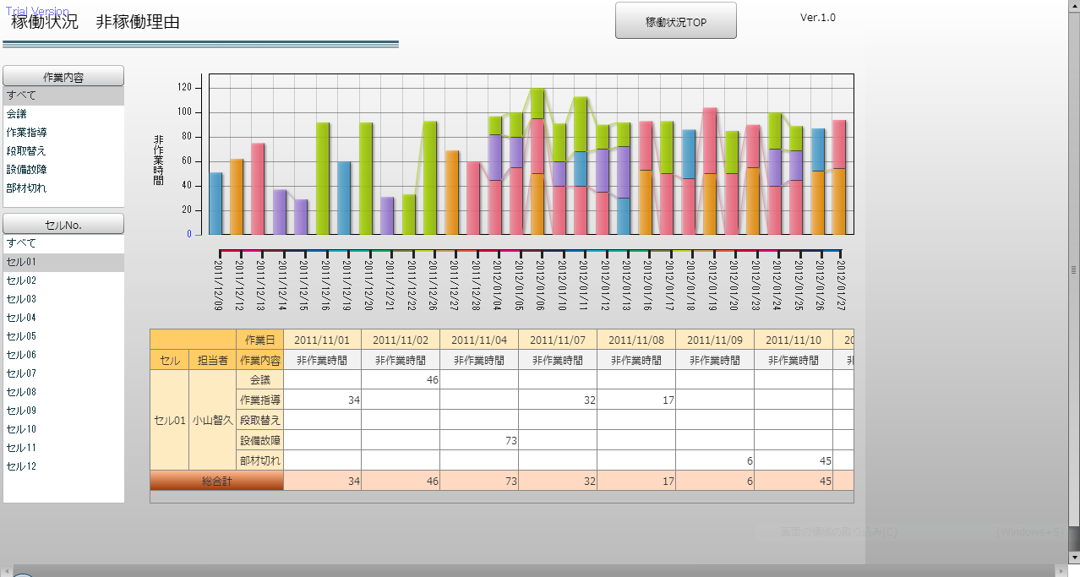

Functions for integration with MotionBoard and Dr.Sum
Automatic generation of tables by business form suitable for analysis and aggregation, in conjunction with WingArk's Motion Board and Dr. Sum
Definition
Creating and editing form definitions
Definition Information
MotionBoard
ConMas Designer
Sheet 1
Sheet 2
Sheet 3
Creation
Integration Table generation process
Integration table by definition exists as a work table for each form definition.
Integration tables by definition
Reference
Data can be analysed in various expressions from WingArk's dashboard solution MotionBoard and BI/data utilisation solution Dr.Sum using linkage tables created for aggregation
Integration table function
Integration table addition/update process
Form 1
Form 2
Dr. Sum
Other integration systems
Automatic reflection of data in the linked table, and having one record per form enables aggregation of the same items by GROUP BY, SUM, etc. in SQL.
Form 3
Forms
postgreSQL Client
Register
Filling in and registering forms
Form information
Business data per form can be aggregated in SQL using connection modules and drivers such as "postgreSQL" client middleware.
It is also possible to cut and pace data from the 'postgreSQL' management tool
Sheet 1
Sheet 2
Sheet 3

